Slide 1
Conceptual Data Modeling Using Entities and Relationships
High-level conceptual data models for database design
A sample database application
Entity types, entity sets, attributes and keys
Relationship types, relationship sets, roles
Notation for entity-relationship diagrams
Relationship types of degree higher than two
Relational database design using ER-to-relational mapping
Summary

Slide 2
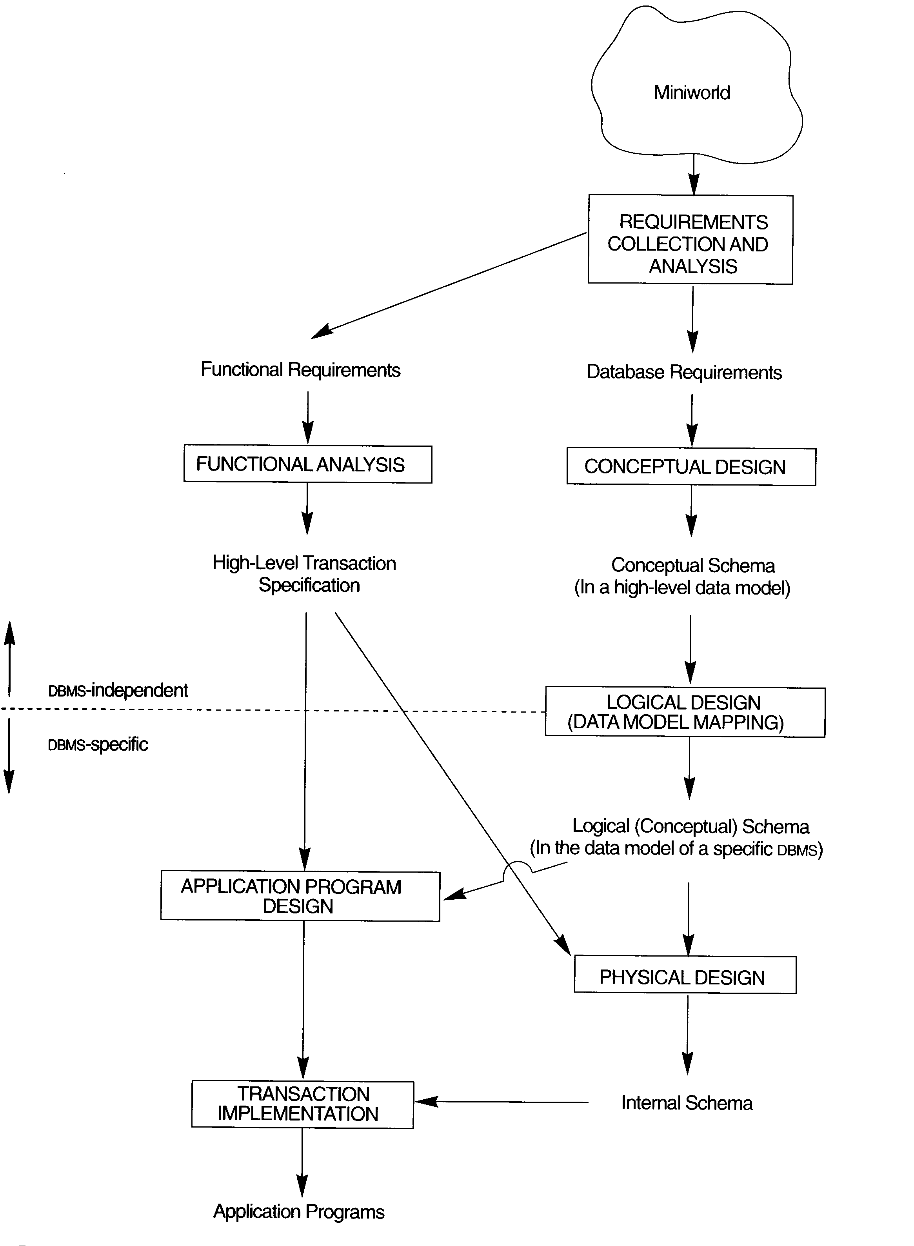
Main phases of database design

Slide 3
ER model concepts
Entity: A ”thing” in the real world (physical or conceptual)
Attribute: Particular properties of an entity
Type of attributes
Simple vs composite
Single-valued vs multivalued
Stored vs derived

Slide 4
An example database: COMPANY
The company is organized into departments. Each department has a unique name, a unique number, and a particular employee who manages the department.
A department may have several locations.
A department controls a number of projects, each of which has a unique name, a unique number, and a single location.

Slide 5
An example database: COMPANY (cont’d)
We store each employee’s name, social security number, address, salary, sex, and birth date.
An employee is assigned to one department but may work on several projects, which are not necessarily controlled by the same department.
We keep track of the number of hours per week that an employee works on each project. We also keep track of the direct supervisor of each employee.
We want to keep track of the dependents of each employee for insurance purposes. We keep each dependent’s first name, sex, birth date, and relationship to the employee.

Slide 6
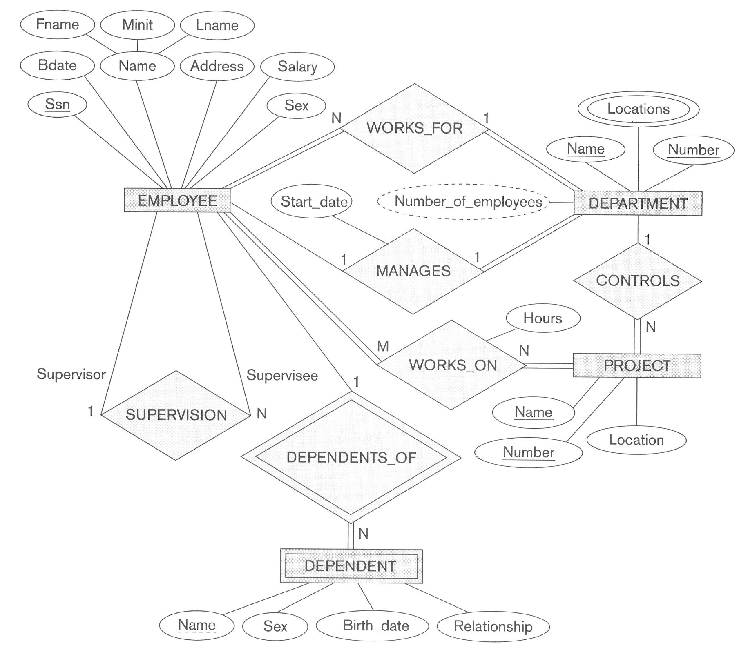
ER schema diagram for the COMPANY database

Slide 7
Entities types, attributes and keys
Entity type defines a set of entities that have the same attributes.
An entity type describes the schema for a set of entities that share the same structure.
Simple vs composite
Single-valued vs multivalued
Stored vs derived

Slide 8
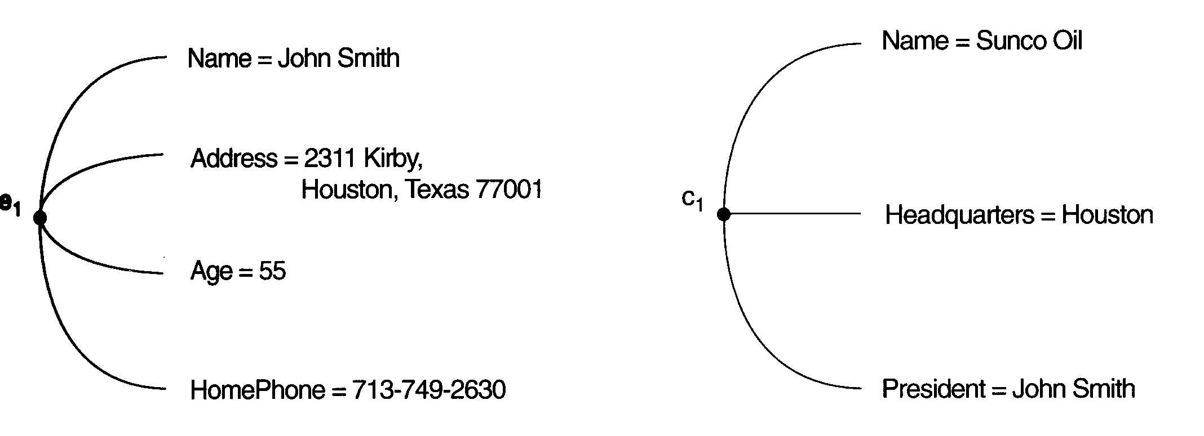
Two entities: e₁ and c₁

Slide 9
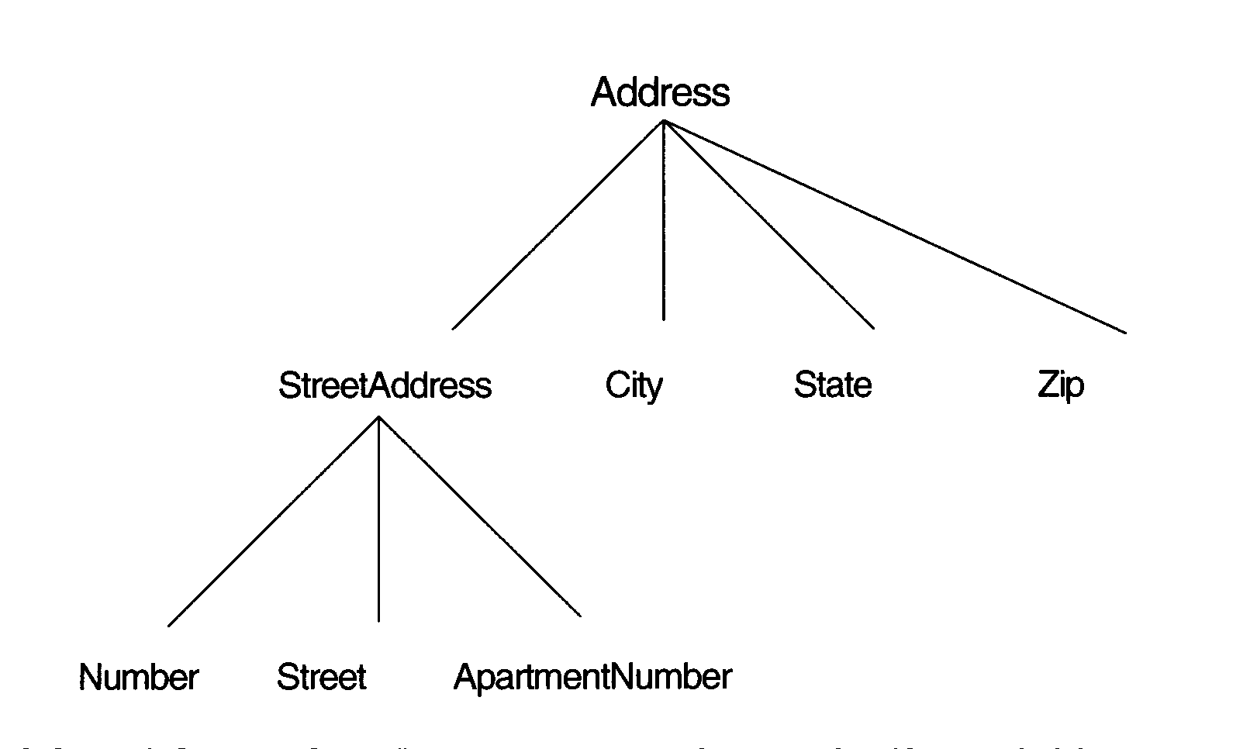
A hierarchy of composite attributes

Slide 10
Keys and value sets
An important constraint on the entities of an entity type is the key or uniqueness constraint.
Each simple attribute of an entity type is associated with a value set (or domain of values).

Slide 11
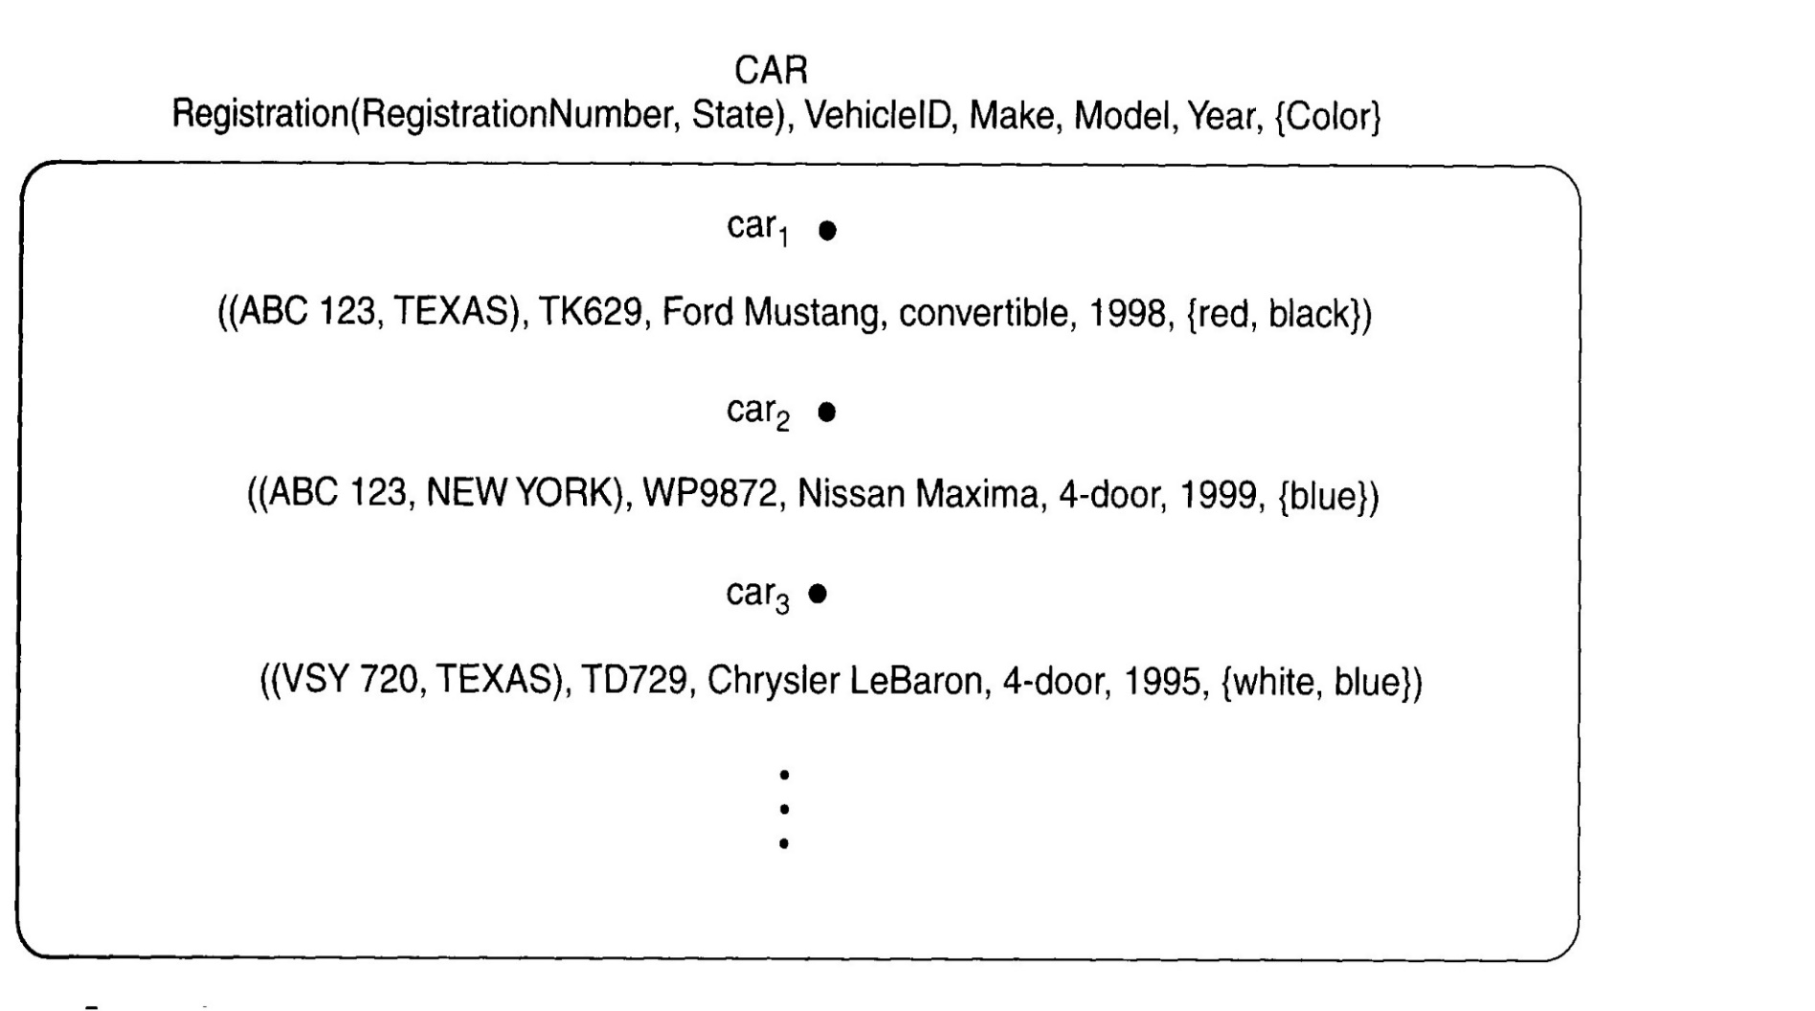
CAR entity type

Slide 12
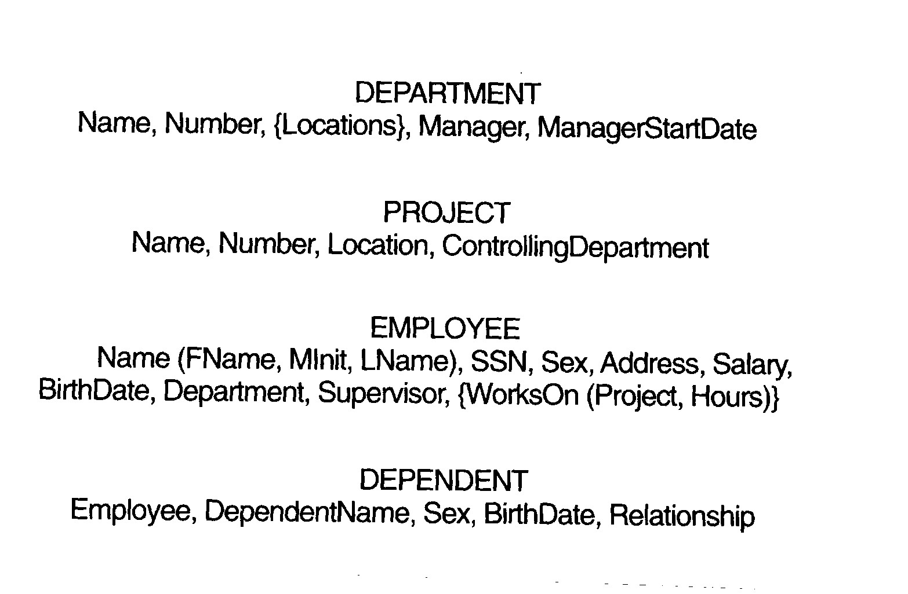
Preliminary design of COMPANY database

Slide 13
Relationships, roles, and structural constraints
Relationship types and relationship instances
Degree: number of participating entity types
Role names and recursive relationships
Cardinality ratio
1:1 (one to one)
1:N (one to many)
M:N (many to many)

Slide 14
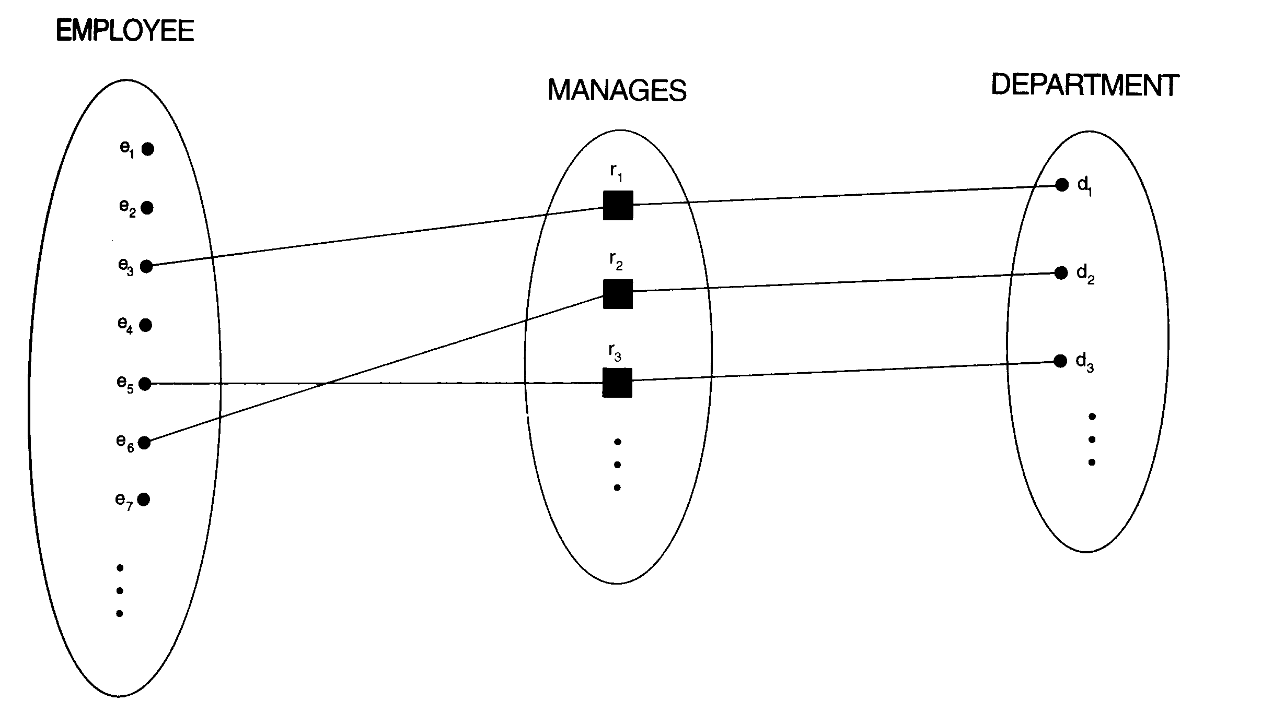
1:1 relationship MANAGES

Slide 15
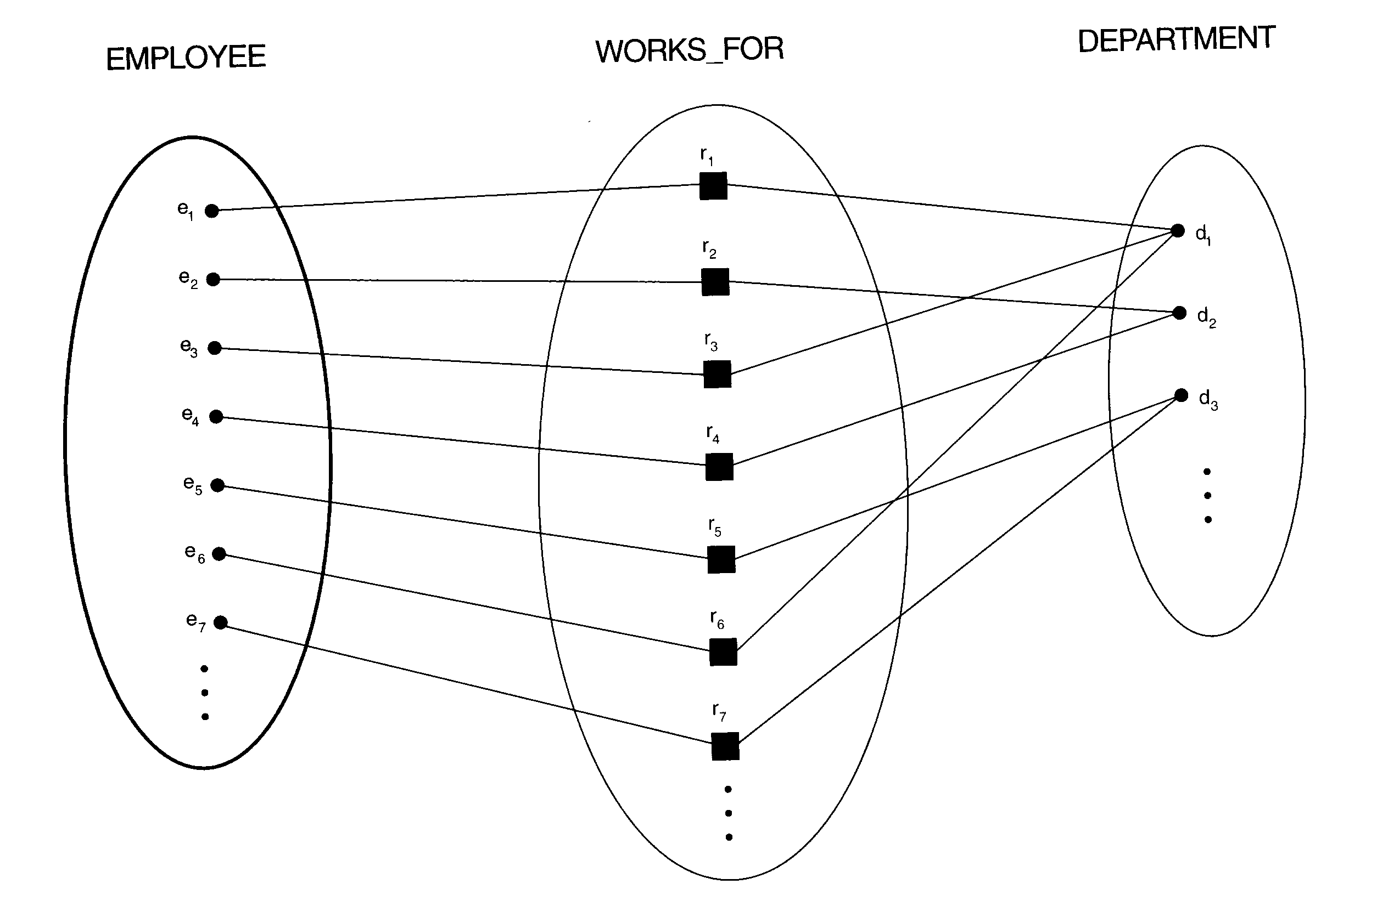
WORKS_FOR relationship

Slide 16
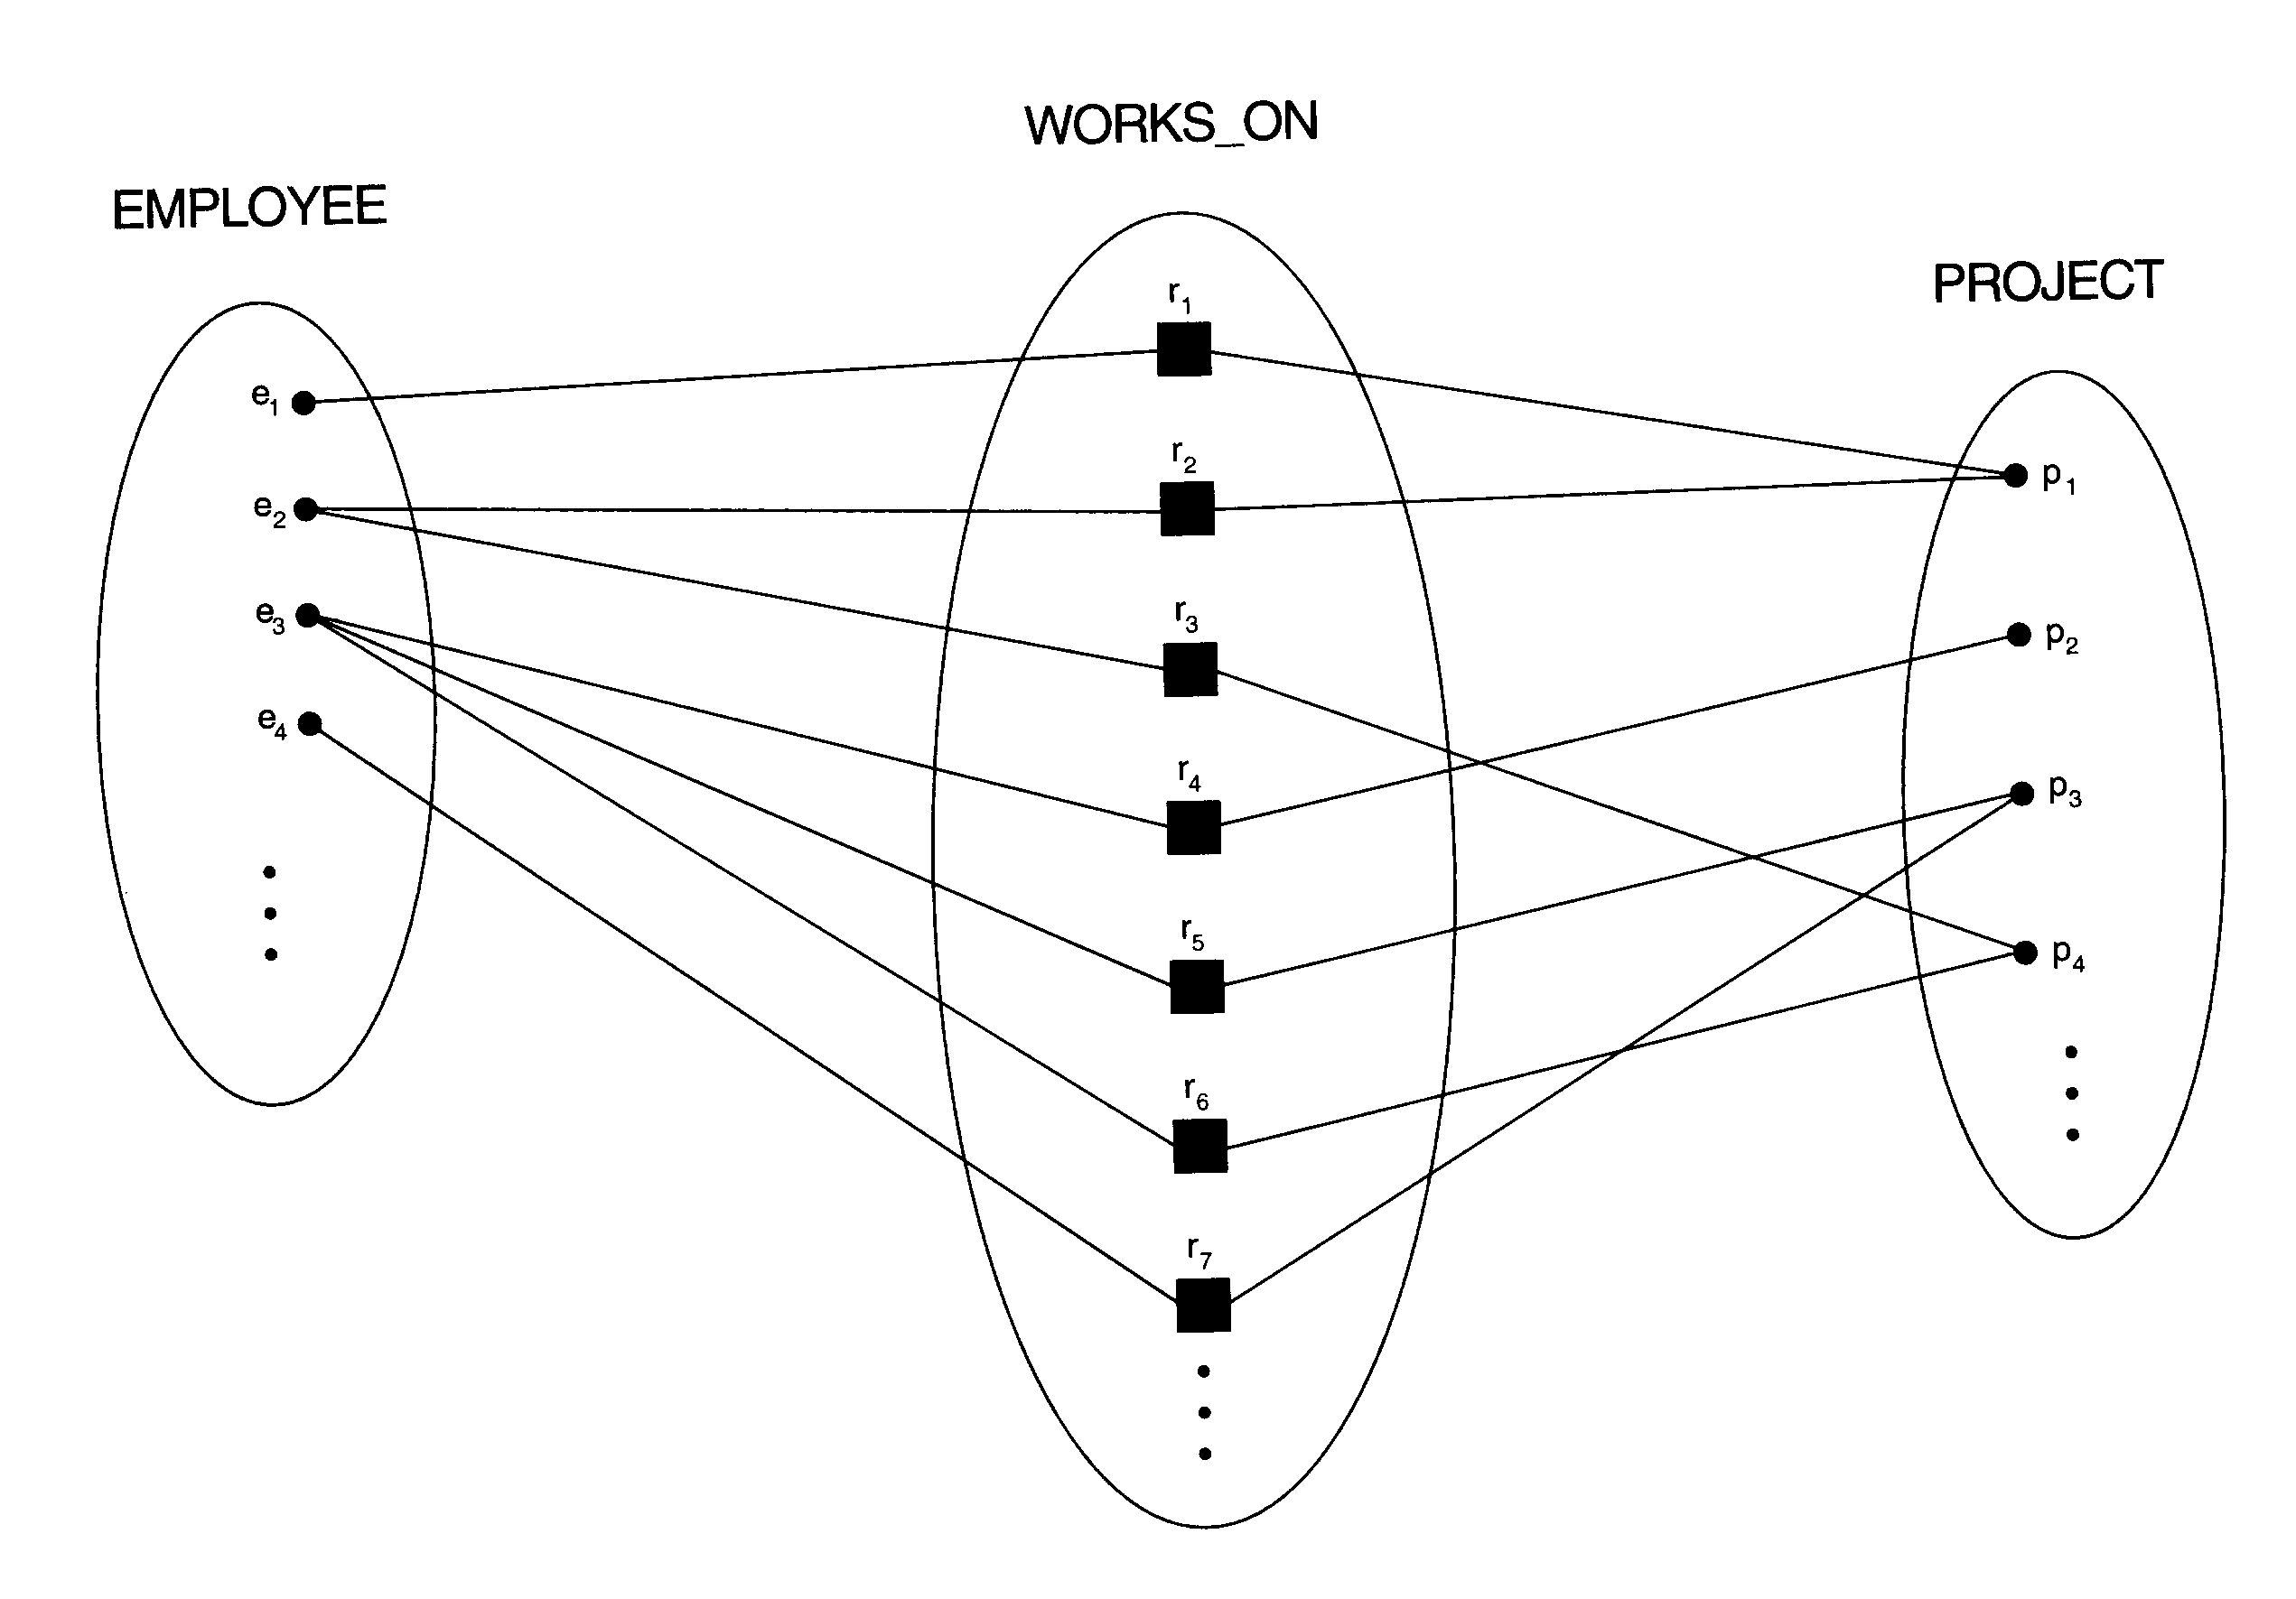
M:N relationship WORKS_ON

Slide 17
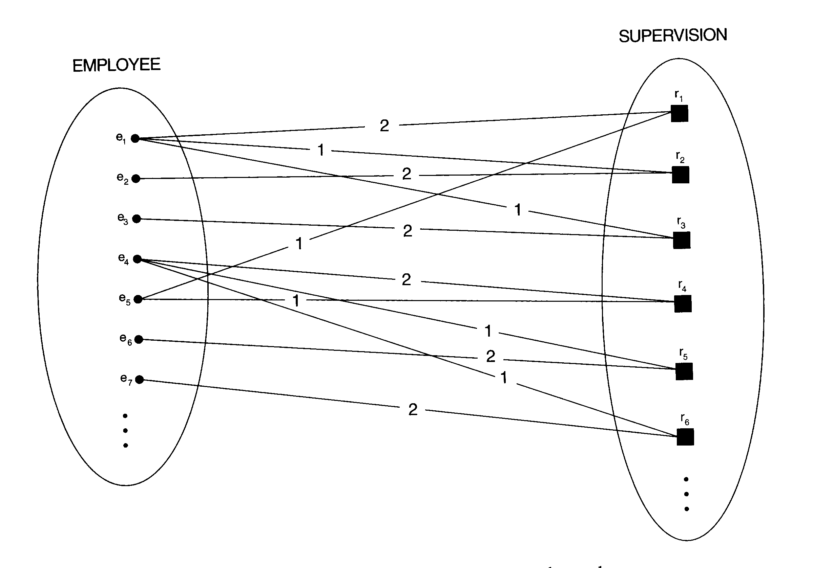
A recursive relationship SUPERVISION
The EMPLOYEE entity plays two roles of supervisor (1) and supervisee (2)

Slide 18
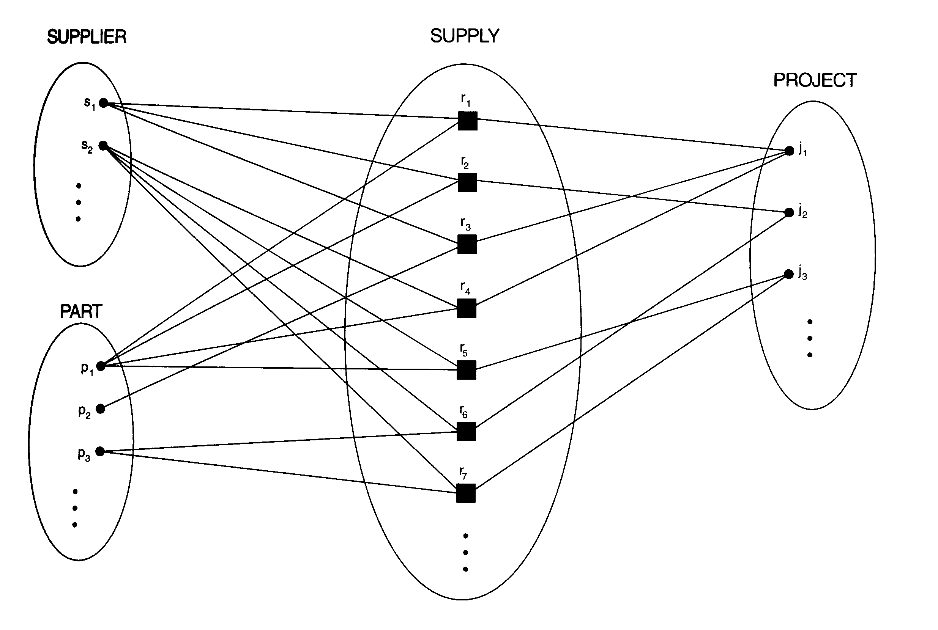
A ternary relationship SUPPLY

Slide 19
Constraints and weak entity types
Participation constraints: Whether the existence of an entity depends on its being related to another entity via the relationship type
Total (existence dependency)
Partial
The participation of EMPLOYEE in WORKS_FOR is called total.
The participation of EMPLOYEE in MANAGES is partial.
Weak entity types: some entity types that may not have any key attributes of their own
A weak entity type always has a total participation constraint and a partial key.

Slide 20
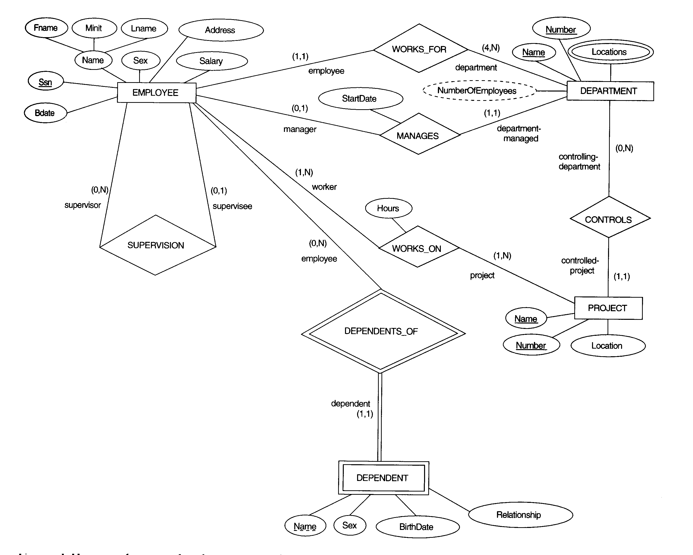
ER diagram for the COMPANY schema

Slide 21
Relational Database Design by ER-to-Relational Mapping
Relational database design using ER-to-relational mapping
Summary

Slide 22
ER-relational mapping algorithm
Step 1: Mapping of regular entity types.
For each regular entity type E in the ER schema, create a relation R that includes all the simple attributes of E.
Include only the simple component attributes of a composite attribute.
Choose one of the key attributes of E as primary key for R.
If the chosen key of E is composite, the set of simple attributes that form it will together form the primary key of R.

Slide 23
Company schema
ER diagram for the COMPANY schema

Slide 24
Example of step 1
For example, we create the relations EMPLOYEE, DEPARTMENT, and PROJECT for the regular entity types EMPLOYEE, DEPARTMENT, and PROJECT in COMPANY ER schema.
Then, we choose SSN, DNUMBER and PNUMBER as primary keys for the relations EMPLOYEE, DEPARTMENT, and PROJECT, respectively.
Note: Foreign keys are not included yet.

Slide 25
Step 2: Mapping of weak entity types
For each weak entity type W in the ER schema with owner entity type E, create a relation R, and include all simple attributes of W as attributes of R.
Include as a foreign key attributes of R the primary key attribute(s) of the relation(s) that correspond to the owner entity type(s).
The primary key of R is the combination of the primary key(s) of the owner(s) and the partial key of the weak entity type W.

Slide 26
Example of step 2
For example, we create the relation DEPENDENT in this step.
Include the primary key SSN of the EMPLOYEE as a foreign key attribute of DEPENDENT.
The primary key of DEPENDENT is the combination {ESSN, DEPENDENT_NAME} because DEPENDENT_NAME is the partial key of DEPENDENT.

Slide 27
Step 3: 1:1 relationship types
For each binary 1:1 relationship type R in the ER schema, identify the relations S and T that correspond to the entity types participating in R.
Include the primary key of T as a foreign key in S.
It is better to choose as entity type with total participation in R.
Include all the simple attributes of the 1:1 relationship type R as attributes of S.
Note: When both participations are total, we may merge the two entity types and the relationship into a single relation.

Slide 28
Example of step 3
Let’s consider the relationship type MANAGES which is total.
Include the primary key of EMPLOYEE as foreign key in the DEPARTMENT and rename it as MGRSSN.
Include the simple attribute StartDate of the MANAGES in the DEPARTMENT and rename it MGRSTARTDATE.

Slide 29
Step 4: 1:N relationship types
For each regular 1:N relationship type R, identify the relation S that represents the participating entity type at the N-side of R.
Include the primary key of the relation T as a foreign key in S that represents the other entity type participating in R.
Include any simple attributes of the 1:N relationship type as attributes of S.

Slide 30
Example of step 4
Let’s consider the 1:N relationships type WORKS_FOR, CONTROLS and SUPERVISION.
For WORKS_FOR, include the primary key DNUMBER of DEPARTMENT as a foreign key in EMPLOYEE and call it DNO.
For SUPERVISION, include the primary key SSN of EMPLOYEE as a foreign key in itself and call it SUPERSSN.
For CONTROLS, include the primary key DNUMBER of DEPARTMENT as a foreign key in PROJECT and call it DNUM

Slide 31
Step 5: M:N relationship types
For each M:N relationship type R, create a new relation S to represent R.
Include as foreign key attributes in S the primary keys of the relations that represent the participating entity types; their combination will form the primary key of S.
Include any simple attributes of the M:N relationship type as attributes of S.
Note: We cannot represent an M:N relationship type by a single foreign key attribute.

Slide 32
Example of step 5
Let consider the M:N relationship type WORKS_ON.
Include the primary keys of the PROJECT and EMPLOYEE relations as foreign keys in WORKS_ON and rename then PNO and ESSN, respectively.
Include an attribute HOURS in WORKS_ON.
Note: The propagate (CASCADE) option for the referential triggered action should be specified on the foreign keys in the relation corresponding to R, since each relationship instance has an existence dependency on each of the entities it relates.

Slide 33
Step 6: Multivalued attributes
For each multivalued attribute A, create a new relation R.
Include an attribute corresponding to A, plus the primary key attribute K as a foreign key in R.
The primary key of R is the combination of A and K.

Slide 34
Example of step 6
Let’s consider the attribute DLOCATION.
Create a relation DEPT_LOCATIONS.
The primary key of DEPT_LOCATIONS is the combination of {DNUMBER, DLOCATION}.
Note: The propagate (CASCADE) option for the referential triggered action should be specified on the foreign key in the relation corresponding to the multivalued attribute.

Slide 35
Step 7: N-ary relationship types
For each n-ary relationship type R, when n > 2, create a new relation S to represent R.
Include as foreign key attributes in S the primary keys of the relations that represent the participating entity types.
Include any simple attributes of the n-ary relationship type as attributes of S.
The primary key of S is usually a combination of all the foreign keys that reference the relations representing the participating entity types.

Slide 36
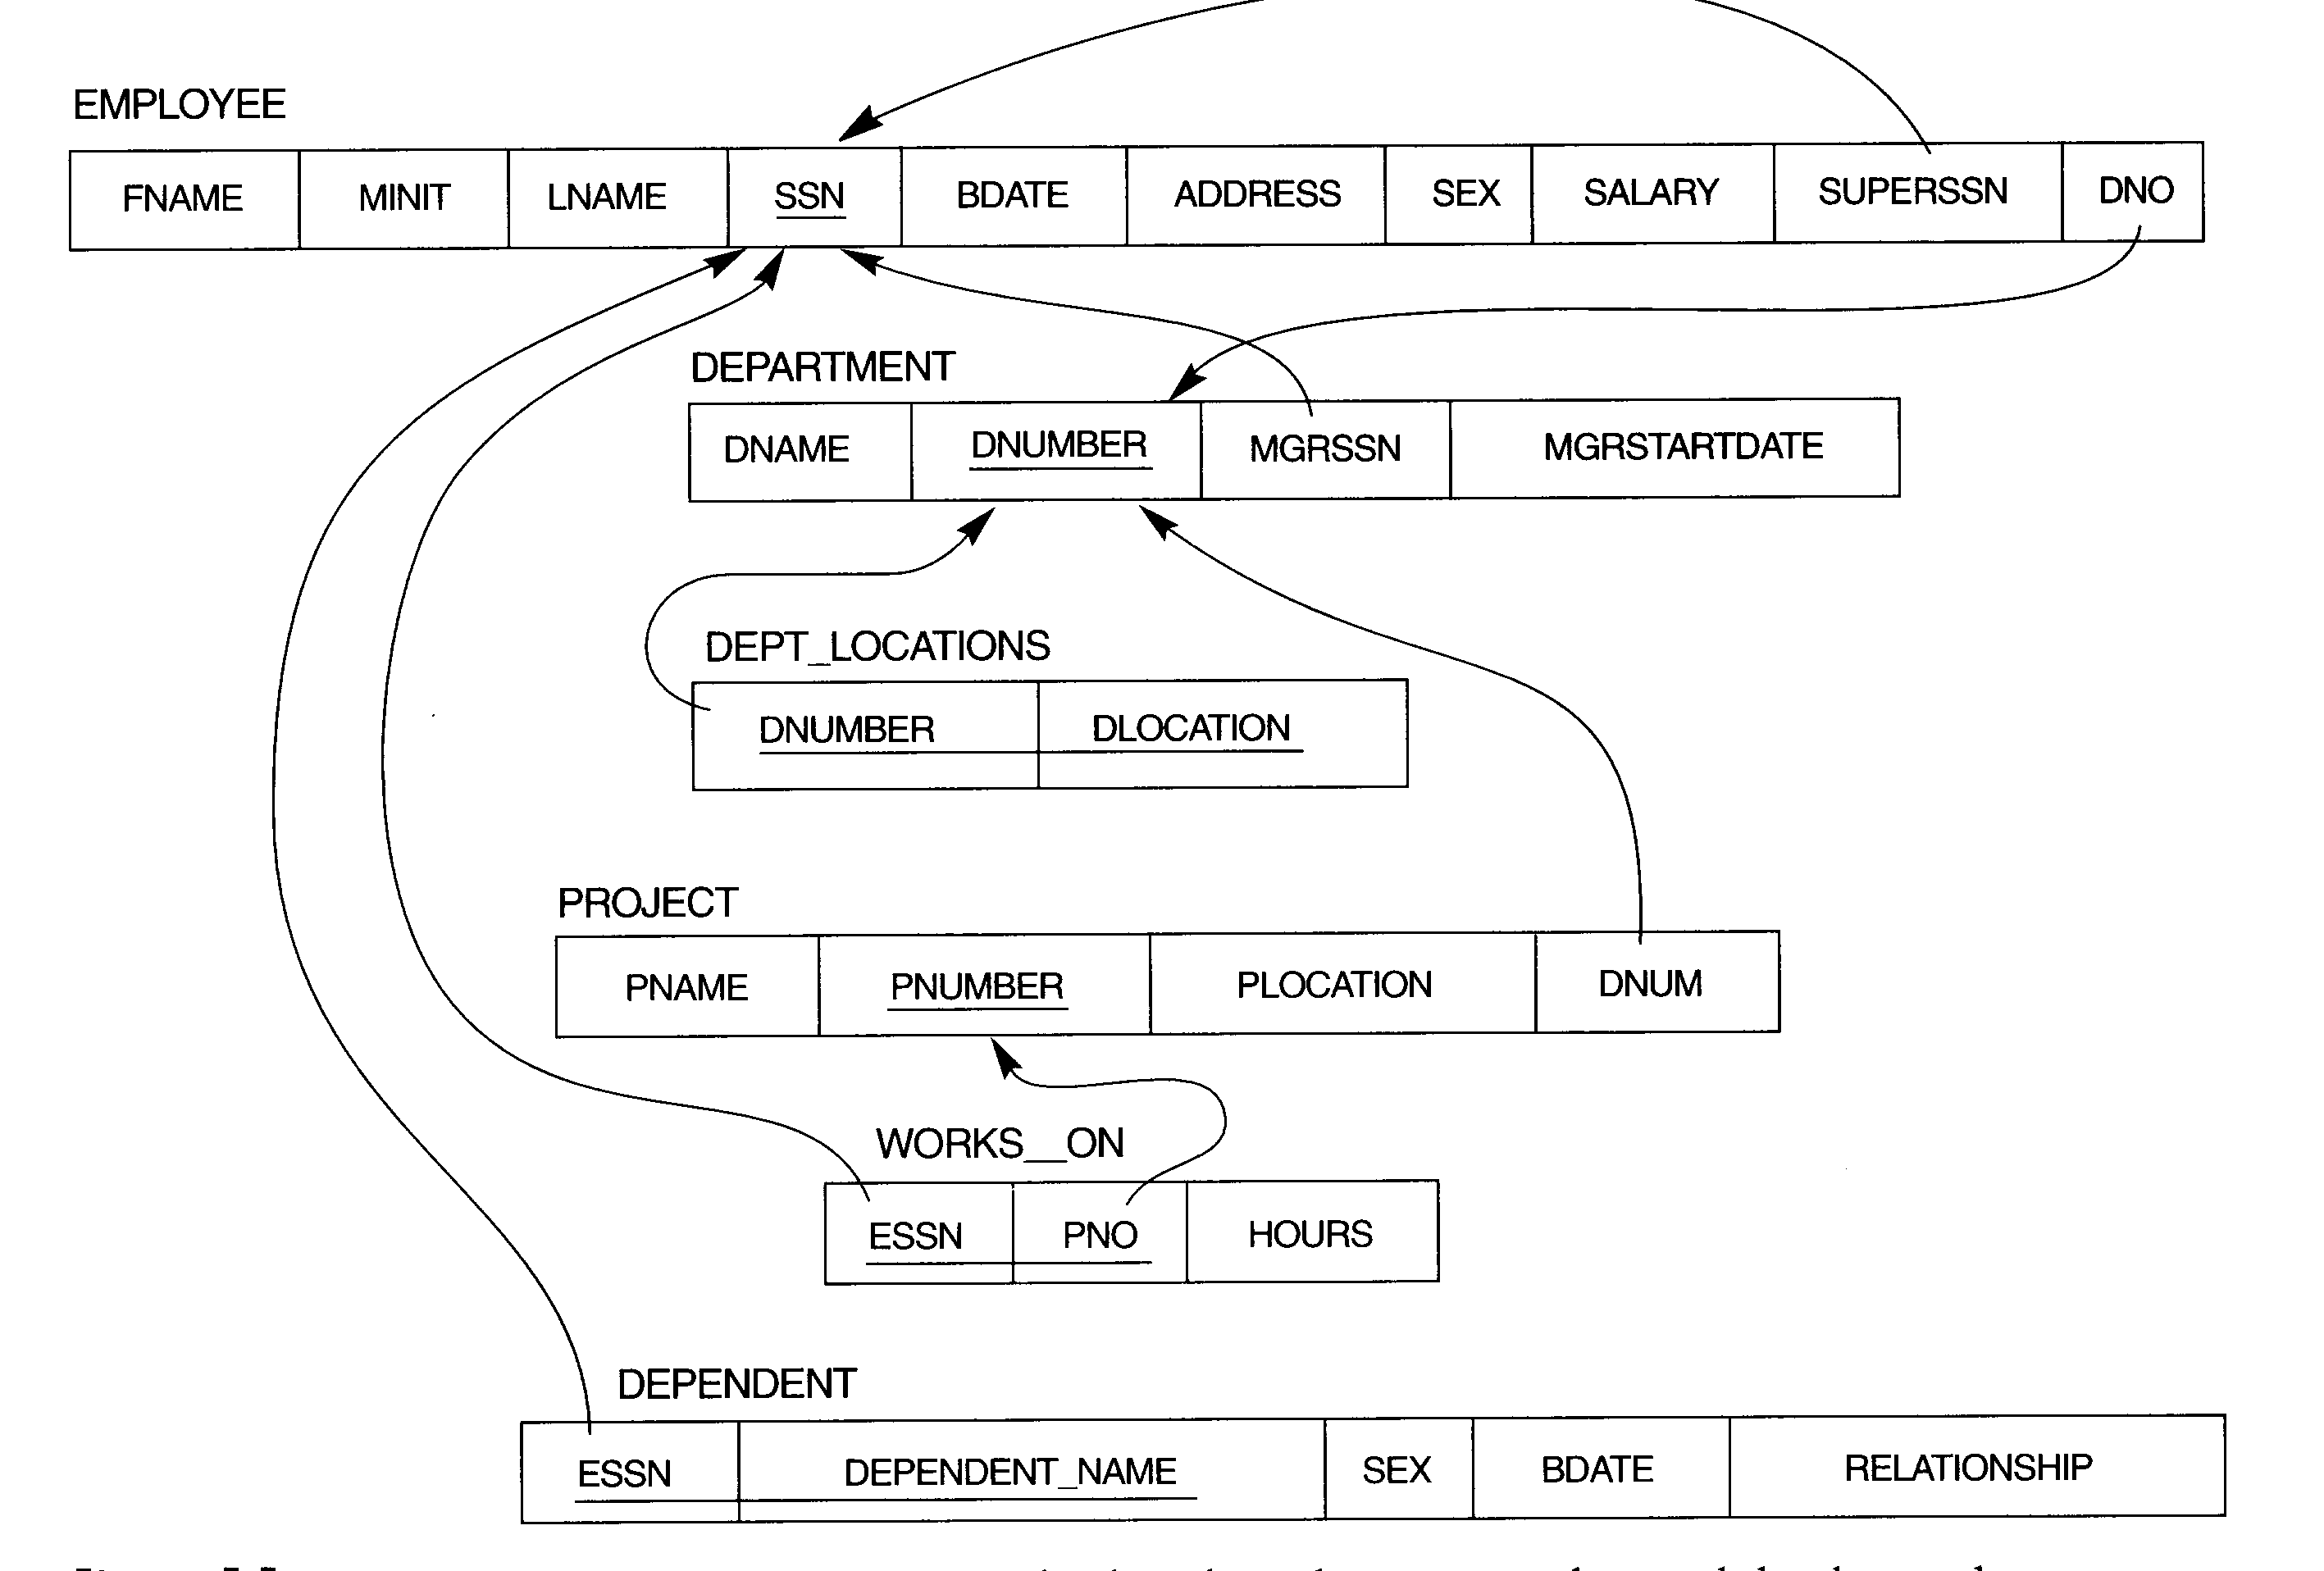
Relations of COMPANY

